Slide 1



SMART INDIA HACKTHON 2025
Problem Statement ID : SIH 25114
Problem Statement Title: swadeshi for Atmanirbhar Bharat
(student innovation)
Theme: Bio Tech/Med Tech
PS Category: Software
Team ID: -73227
Team Name: IDEA HACKERS.

Slide 2


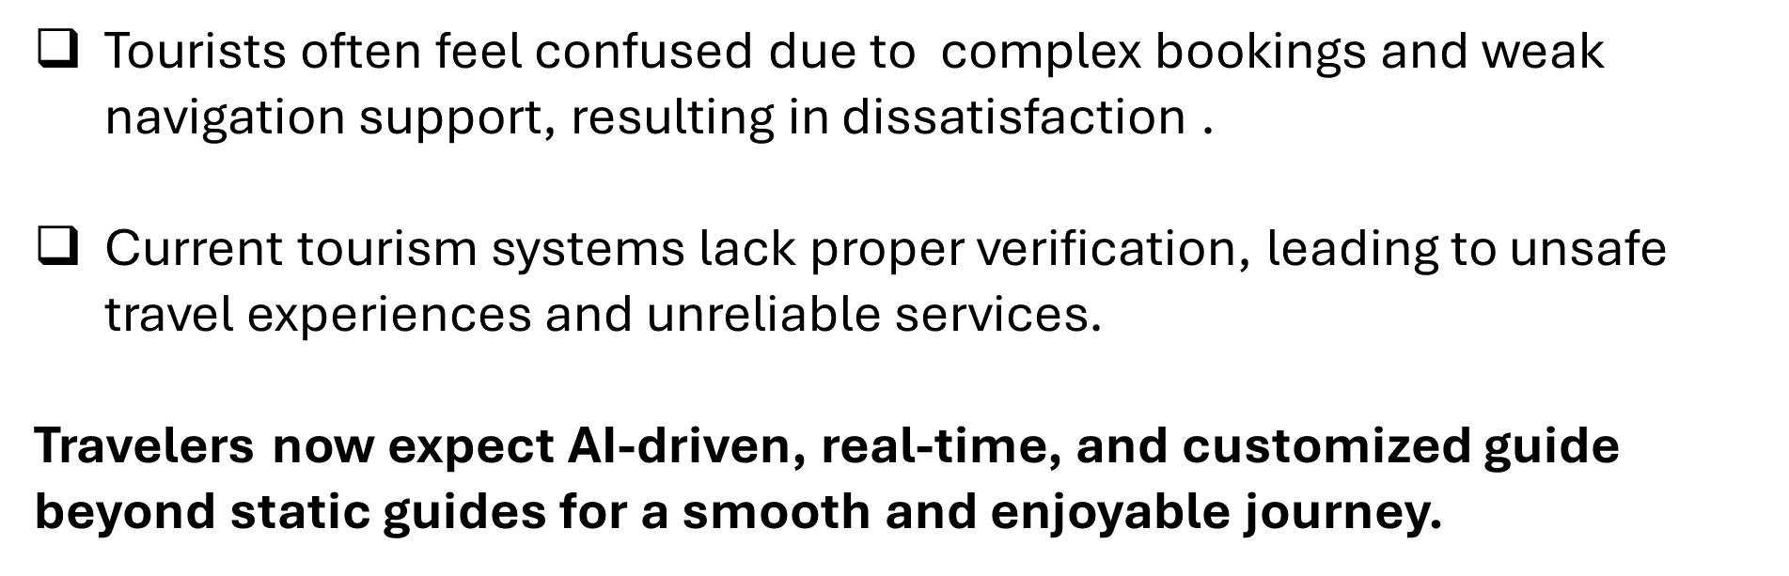

Slide 3

WHAT IS OUR SOLUTION?
AI-powered personalized filters to tailor your responses , services, and experiences to each traveller’s needs.
Real-time location tracking, anomaly detection, and SOS alerts to ensure tourist security throughout the journey.
Secure communication, verified credentials, and fraud prevention through blockchain-based tourist IDs and QR verification.

Slide 4

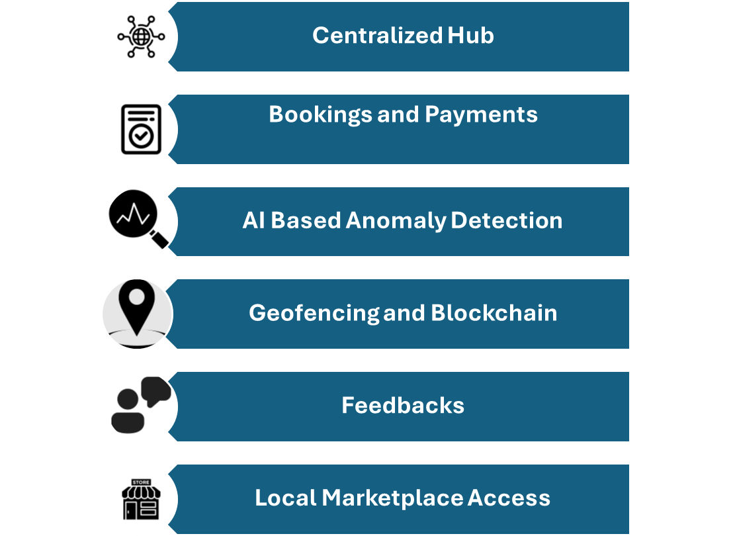
FEATURES
@SIH Idea submission- Template

Slide 5
CENTRALIZED HUB
Instead of tourists using multiple apps/websites for hotels, transport, guides, events, and attractions, our platform brings everything into one single ecosystem.
Local Empowerment
Verified homestays, artisans, and marketplaces are included, boosting local communities.
One-Stop Platform
Travelers can book hotels, hire guides, arrange transport, and explore attractions without switching between different services.
AI-Powered Personalization
The hub creates smart itineraries based on user preferences, time, and budget.
Secure Bookings & Payments digital authentication ensures providers are verified, reducing fraud.

Slide 6
BOOKINGS AND PAYMENTS
One-Click Bookings
Tourists can instantly book accommodations, rides, or tickets within the app.
Secure Transactions
Blockchain and digital authentication ensure payments are fraud-free and providers are verified.
Multi-Mode Payments
Supports cards, UPI, wallets, and international payment gateways.
Integrated with AI Itinerary Bookings are auto-suggested based on the traveler’s personalized plan.
Transparent Pricing
No hidden charges; real-time updates on costs and availability.

Slide 7

AI BASED ANAMOLY DETECTION
This feature uses AI to continuously monitor tourist activity, location, and system behavior. If something unusual happens, the system detects it in real time and triggers alerts.
Data Collection
Tracks tourist movements, bookings, payments, and activity patterns.
AI Monitoring
Learns what “normal” travel behavior looks like (e.g., expected route)
Anomaly Detection
Flags unusual activities such as sudden location changes, fake logins, or abnormal booking attempts.
Alert & Action
Sends instant notifications to tourists, authorities, or caregivers with SOS and corrective measures.
@SIH Idea submission- Template

Slide 8

GEO FENCING
This feature uses virtual boundaries to detect when a tourist enters or exits sensitive, restricted area.
SETTING UP GEO-FENCES
REAL TIME ALERTS
The tourist app tracks live GPS data (with user consent).
When a tourist's location crosses into a geo-fenced zone, the system triggers an alert.
Authorities define specific Zones as restricted areas(e.g., border areas, wildlife zones, unsafe regions).
These zones are marked as virtual boundaries using GPS coordinates.
@SIH Idea submission- Template
It Prevents tourists from unknowingly entering unsafe zones
@SIH Idea submission- Template

Slide 9

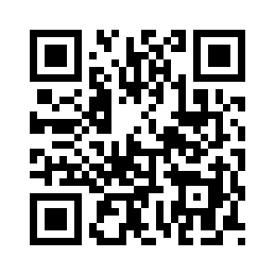
BLOCKCHAIN-BASED DIGITAL TOURIST ID
We use Blockchain-based Digital Tourist ID to prevent the use of fake identities by ensuring tourist's information is securely verified.
HOW IT WORKS?
When a tourist registers (hotel), they provide KYC details (like Aadhaar/passport).
The system generates a unique digital ID that is valid only for the duration of their trip.
This data is stored on a blockchain, making it tampered-proof(can’t be changed).
QR-VERIFIABLE AT CHECKPOINTS
Each tourist is given a QR code linked to their digital ID.
At hotels, police checkpoints, or tourist entries, officials can scan the QR code using a verification tool.
The system instantly checks if the ID is valid .Hash functions(SHA-256)can be used.
The QR code represents a digital ID that’s only valid for the tourist’s specific trip dates (e.g., from Sept 10 to Sept 20). No one can reuse this after the trip ends.

Slide 10
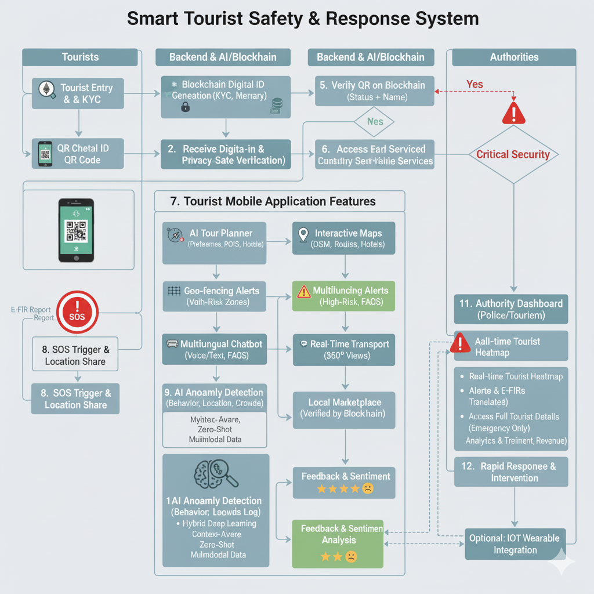
Flowchart:
@SIH Idea submission- Template

Slide 11
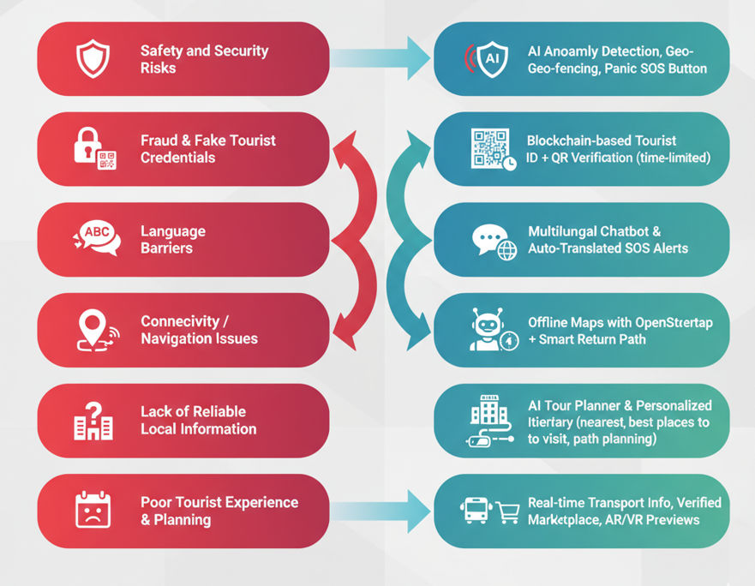
FEASIBILITY AND VIABILITY
s
an
Potential Risks & Challenges
Our Feasible solution

Slide 12


